Slide 1
Agenda
YCQL Database Hierarchy
Understanding Primary Keys
partition column – mandatory
clustering column (optional)
Sort operation
Secondary Index
Query Plan
Storage
Product Line – Yugabyted, YBAnywhere, YBManaged
Fault Tolerance

Slide 2
Fundamental YCQL Concepts

Slide 3
Database Hierarchy – Database – Keyspace - Table
Database Runs in a Cluster - Usually distributed on multiple nodes
Database contains 1 or more Keyspaces
Logical Container, similar to Oracle Schema
A Keyspace contains tables
A table must have a primary key (PK).
Within the PK, The first column or groups of columns in “()” is partition key.
2nd onwards columns are sort keys
Partition key is mandatory

Slide 4
Database Hierarchy – Database – Keyspace - Table
Connect to the database using CLI
Connect to the database using “ycqlsh” cli ( like Oracle Sqlplus ) – using a username and password
Ycqlsh – a shell script that calls a python script. Similar to “cqlsh” command line ‘
Connect to any one node of the cluster – it works!
For the rest of this deck, assume you connect as the table owner ignoring grants / access control
Ycqlsh <db_host_ip> –u <username> -p <pw> [ or without –p, prompts for pw ]

Slide 5
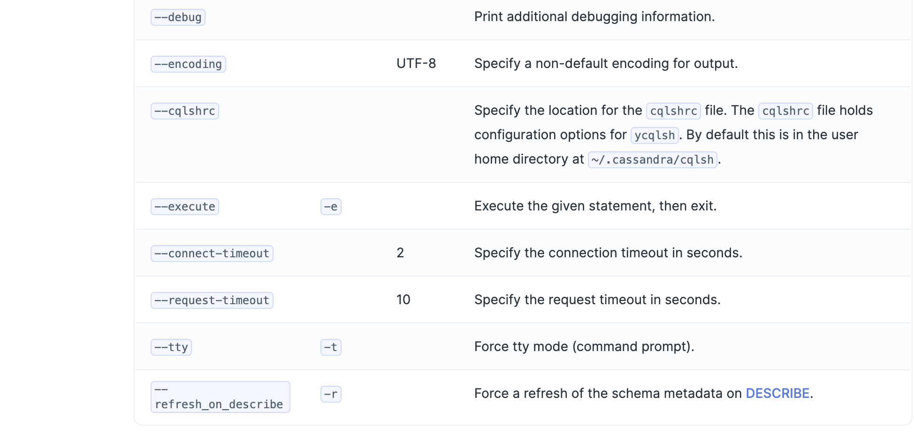
Ycqlsh options
Source: https://docs.yugabyte.com/preview/admin/ycqlsh/

Slide 6
Primary Key With Partition Key – Mandatory In Each Table
Sort Key – Optional
ycqlsh> create keyspace test ;
ycqlsh> use test ;
Ycqlsh:test>create table t1 (c1 int, c2 int, c3 int, c4 int , primary key ((c1, c2), c3)) with transactions = { 'enabled' : true } ;
(c1, c2) → Partition key of the PK.
c3 → Sort key of the PK.
Partition is by hash only. No range partition here.
ycqlsh:test> create table t2 ( c1 int primary key , c2 text ) with transactions = { 'enabled' : true } ;
C1 → Partition key of the PK. No sort key for this PK
transactions = { 'enabled' : true } → Default is false. Enables multi-statement transactions like RDBMS. More on this later.

Slide 7
Partition columns of the PK
A table row is co-located with its primary key ( like Oracle Index Organized Table )
Query using one value of PK columns is a single fetch, unlike most regular RDBMS heap tables – one for PK and one for table.
partition_hash → Function to compute hash value on partition columns of the PK ( doc ). It ranges from 0 to 65535, in hex 00 – FF.
ycqlsh:test> select c1, c2, c3, c4, partition_hash ( c1, c2 ) from t1 ;
c1 | c2 | c3 | c4 | partition_hash(c1, c2)
----+----+----+----+------------------------
11 | 21 | 31 | 41 | 39978
10 | 20 | 30 | 40 | 62559
10 | 20 | 300|400 | 62559
Partition_hash function an be used to break up the full range of table into slices for parallel scans Like ycrc for doing a count of rows of a table
It decides which tablet the row will be residing in. You should have high cardinality on partition columns.
For an efficient query using PK so that it reads a single partition, the query must include → Where c1 = X and c2 = Y
i.e. Both partition columns with equality signs only – no greater than, less than or range etc.
Similar function for Ysql -> yb_hash_code

Slide 8
Sort – only on Clustering columns, only Within a partition
ycqlsh:test> select c1, c2, c3, c4, partition_hash ( c1, c2 ) from t1
where c1 = 10 and c2 = 20 order by c3 desc ; → Works!
c1 | c2 | c3 | c4 | partition_hash(c1, c2)
----+----+-----+-----+------------------------
10 | 20 | 300 | 400 | 62559
10 | 20 | 30 | 40 | 62559
Note: You can only sort on the clustering columns on an index ( in this case the index is PK )
Even then it works only within a single partition (i.e. within a specific c1, c2 value )
ycqlsh:test>select c1, c2, c3, c4 from t1 where c1 = 10 order by c3 ; → No c2
message=”…All hash columns must be set if order by clause is present
ycqlsh:test>select c1, c2, c3, c4 from t1 where c1 = 10 and c2 = 20 order by c4 ;→ c4 not sort col
message=”..Order by clause should only contain clustering columns
Create a secondary index to sort on other non-PK columns.

Slide 9
Wrapping up.. Primary Key
CREATE TABLE test.city_population1 (
country TEXT,
city TEXT,
population INT,
PRIMARY KEY (country, city)) WITH CLUSTERING ORDER BY (city ASC);
Partition Key
Clustering Column
CREATE TABLE test.city_population2 (
country TEXT,
region TEXT,
city TEXT,
population INT,
PRIMARY KEY ((country, region), population) WITH CLUSTERING ORDER BY (population DESC);
Partition Key
Clustering Column

Slide 10
Insert is Upsert, by default
create table t2 (c1 int primary key , c2 text) with transactions = {'enabled' : true};
insert into t2 (c1,c2) values (1,'a') ;
insert into t2 (c1,c2) values (1,’b') ;
select * from t2 ;
c1 | c2
----+----
1 | b
Runs as UPSERT
Insert is an UPSERT By default!
Ran an update
insert into t2 (c1,c2) values (1,'c') if not exists ;
[applied] | c1
-----------+----
False | 1
select * from t2 ;
c1 | c2
----+----
1 | b
can be overridden with an IF NOT EXISTS clause: SQL like
Update rejected

Slide 11
Update is Upsert, By default
Update is Upsert, by default
create table t2 (c1 int primary key , c2 text) with transactions = {'enabled' : true};
insert into t2 (c1,c2) values (1,'a') ;
update t2 set c2 = 'b' where c1 = 2 ;
ycqlsh:test> select * from t2;
c1 | c2
----+----
1 | a
2 | b
delete from t2 where c1 = 2 ;
update t2 set c2 = 'b' where c1 = 2 if exists ;
[applied]
-----------
False
select * from t2;
c1 | c2
----+----
1 | a
Override with an IF EXISTS clause: SQL like
Notes:
Clarify on multi-statement updates with if exists

Slide 12
Update/Delete a row – only find it by using PK
create table t2 (c1 int primary key , c2 text) with transactions = {'enabled' : true};
insert into t2 ( c1, c2 ) values ( 1, 'a' ) ;
update t2 set c1 = 2 where c1 = 1 ; → cannot update PK column
InvalidRequest: Error from server: code=2200 [Invalid query]…
create index idx_t2_c2 on t2 ( c2 ) ;
update t2 set c2 = 'b' where c2 = 'a’; → Only use PK in where clause
Non primary key cannot be used in where clause for write requests
update t2 set c2 = 'b' where c1 = 1 ;
select * from t2 ;
c1 | c2
----+----
1 | b
Update of PK Column not allowed
To update cannot use other columns in
where clause even if indexed
Always use full PK columns

Slide 13
Update a row – specify the full PK columns ( partition and sort, if any )
create table t3 (c1 int,c2 int,c3 text, primary key (c1,c2)) with transactions = {'enabled':true};
insert into t3 (c1,c2,c3) values ( 1, 10, 'a');
update t3 set c3 = 'b' where c1 = 1; → c2 not included
Missing condition on key columns in WHERE clause
update t3 set c3 = 'b' where c1 = 1 and c2 = 10 ;
select * From t3 ;
c1 | c2 | c3
----+----+----
1 | 10 | b
To update a row, mandatory use of ALL PK COLUMNS
in the where clause !
Updated row
Be careful. If you specify non-existing PK values – it does an insert
( default Upsert )
update t3 set c3 = 'b' where c1 = 2 and c2 = 10 ;
ycqlsh:test> select * From t3 ;
c1 | c2 | c3
----+----+----
1 | 10 | b
2 | 10 | b
Inserted row

Slide 14
Additional Indexes Supported
Unlike Cassandra, YCQL supports global secondary index ( index on any columns )
ycqlsh:test> CREATE TABLE test.t2 (c1 int PRIMARY KEY, c2 text ) WITH transactions = {'enabled': 'true’};
Ycqlsh:test> CREATE INDEX idx_t2_c2 ON test.t2 (c2);
Note
Similar to table PK, this index has c2 as partition column
Query on column c2 is useful only with equality predicate, not for c2 > value etc.
Yugabyte automatically adds the primary key columns at the end of this index
Ycqlsh:t est> desc idx_t2_c2 ;
CREATE INDEX idx_t2_c2 ON test.t2 (c2, c1) WITH transactions = {'enabled': 'true’};
Now you can sort by c1, within a c2 value
select * from t2 where c2 = 'a' order by c1 desc ;
c1 | c2
----+----
1 | a
Partition Key
“c1”, PK column automatically added to index to find the table row

Slide 15
Using Secondary Index – Index Only Scan
ycqlsh:test> select * from t2 where c2 = 'b' ;
c1 | c2
----+----
2 | b
ycqlsh:test> explain select * from t2 where c2 = 'b’ ;
QUERY PLAN
-------------------------------------------------
Index Only Scan using test.idx_t2_c2 on test.t2
Key Conditions: (c2 = 'b')
Index-only scan – no need to read the tables..
select * from t2 where c2 = 'b' order by c1 ; ← Only this sort is allowed
c1 | c2
----+----
2 | b

Slide 16
Types of Seconday Index
Unique Indexes
Partial Index ( Index only where clause is true )
Covering Index ( Include un-indexed columns for index only fetch )
Or any combination of these – partial unique covering etc.

Slide 17
Transactions – Keep Enabled on Tables / Indexes
In YCQL there is support of muti-row transaction - https://docs.yugabyte.com/preview/api/ycql/dml_transaction/
Indexes of a table follow the transaction support of the table. So if a table is enabled, all indexes have to have transaction enabled and vice versa.
A table needs to have transaction enabled to have secondary index
create table t4 (c1 int primary key , c2 text) with transactions = {'enabled' : false};
create index idx_t4_c2 on t4 ( c2, c1 ) ;
Transactions cannot be enabled in an index of a table without transactions enabled
create index idx_t4_c2 on t4 ( c2, c1 ) with transactions = {'enabled' : false} ;
Invalid Table Definition. Transactions cannot be enabled in an index of a table without transactions enabled.
create index idx_t4_c2 on t4 ( c2, c1 ) with transactions = {'enabled' : false, 'consistency_level' : 'user_enforced' } ; → works, but recommended for most production use cases.

Slide 18
Mutli-Statement Transactions
ycqlsh:test> CREATE TABLE test.t2 ( c1 int PRIMARY KEY, c2 text ) with transactions = {'enabled': 'true’};
select * from t2 ;
c1 | c2
----+----
1 | a
Time | Session 1 | Session 2
t = 0 sec | begin transaction
5 sec | update t2 set c2 = ‘b’ where c1 = 1;
10 sec |  | select * from t2 ; c1 | c2 ----+---- 1 | a
15 sec | update t2 set c2 = ‘c’ where c1 = 1 ; end transaction ;
 | select * from t2 ; c1 | c2 ----+---- 1 | c | select * from t2 ; c1 | c2 ----+---- 1 | c

Slide 19
Multi-Statement Transactions Semantics
Semantics ( Doc )
All tables in transaction block need to have transactions enabled
“If exists” / “If not exists” clause not allowed
There is no explicit rollback ( aborting the transaction is implicit rollback )
DDLs are always executed outside of a transaction block, and like DMLs outside a transaction block, are committed immediately
If transactions are enabled for a table, its indexes must have them enabled as well
If transactions are disabled for a table, its indexes need to have transaction disabled AND consistency_level - ”user enforced” ( 1696 ). → Not recommended for production use.

Slide 20
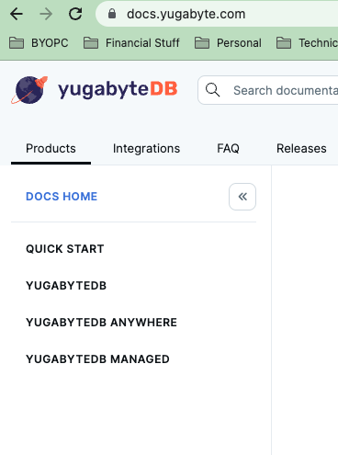
Yugabyte Product Lines
1. YugabyteDB – Core, Open Source DB product
2. YugabyteDB Anywhere – YugabyteDB + “Anywhere”
BBB uses this
UI separate from DB clusters
Create “universes” / clusters easily
Easy Backup, Monitoring
Easy configuration of DB parameters/settings
3. YugabyteDB Managed - YBA on Cloud, PaaS

Slide 21
YugabyteDB Storage – Terminology
LSM tree - Log-structured merge tree
- Efficient data structure for high throughput key-value pair data
- Widely used for NoSQL databases
- Cassandra, Google Bigtable, Hbase, LevelDB, RockDB
- Yugabyte uses DocDB, based on RockDB
SSTable - Sorted String Table – a file format for storing key-value pairs on disk
- Optimized for read
- immutable
Append-only log
- Optimized for write
- When log reaches a certain size ( ~ a few GB ), it is written to SSTable
- Copy of append-only log stays in memory
- Update – new version of row with timestamp
- Delete – new version with key and timestamp – called tombstone
- Old updates and deletes stay in LSM, for MVCC, removed through later through file compaction.
YB compaction - https://www.yugabyte.com/blog/background-data-compaction/
Generic LSM - https://yetanotherdevblog.com/lsm/

Slide 22
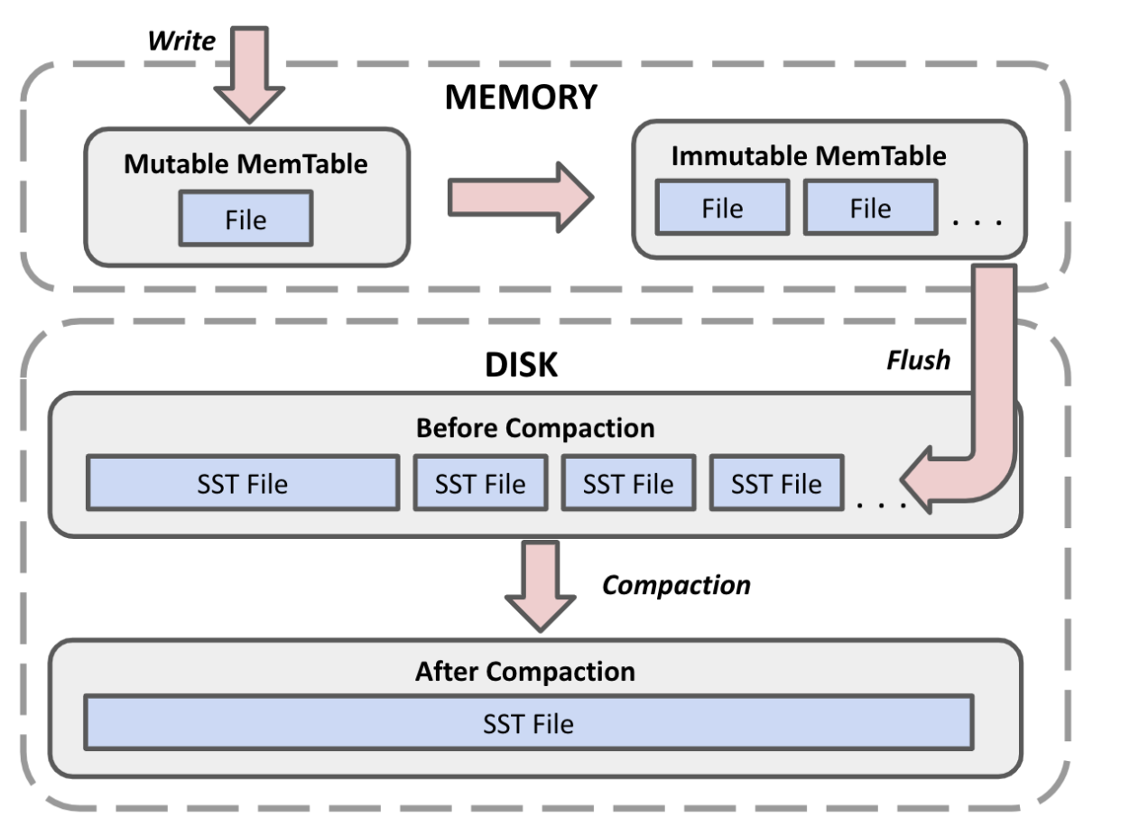
Yugabyte Storage Write Path

Slide 23
YugabyteDB Storage – Read Path
Searching for data in SSTable – can use binary search but
- Key values can be anything, irregular
- Hence a “sparse” index is created – keeping a value for every few KB.
- Sparse index is in memory, it reduces.
- For faster search of values that do not exist, use bloom filter
Read Path
Search if key is present in bloom filter. If yes, returns zero rows
Next, search in append-only Memtable. This is efficiently done using the in-memory map of active log.
If not present, search each SSTable in reverse order i.e. latest first.
This is efficiently done by using the corresponding sparse index which is loaded in memory.
Bloom filter – probabilistic search with some false positives for keys that do not exist

Slide 24
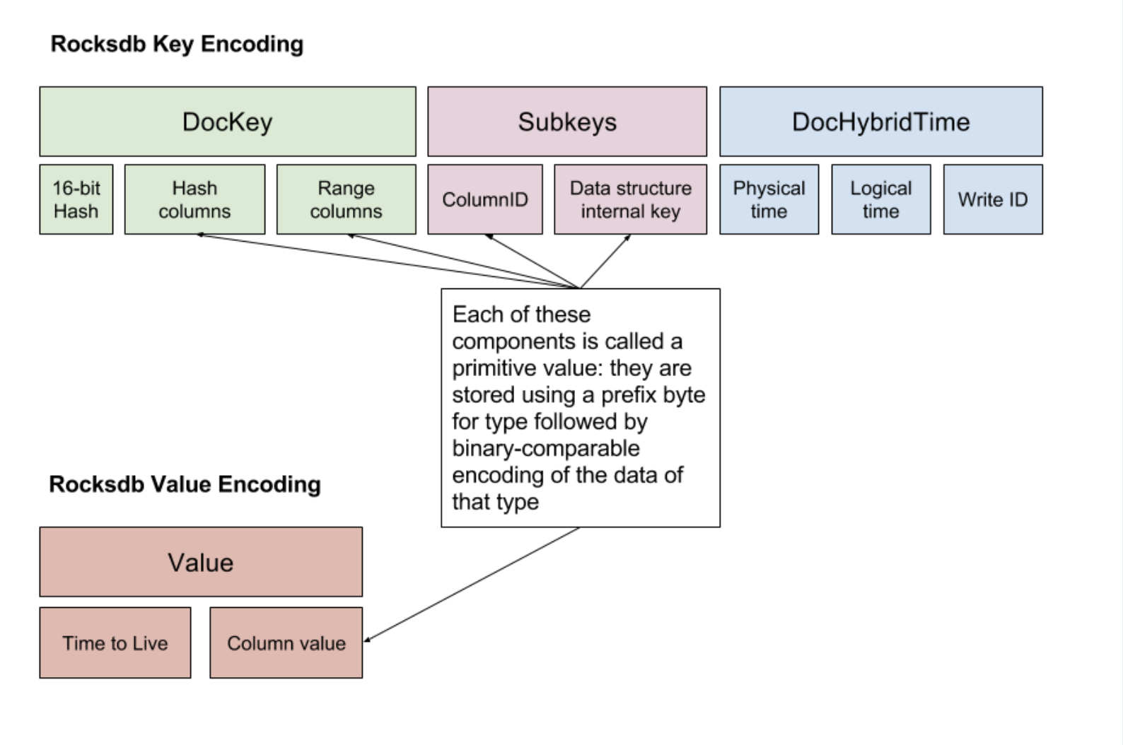
Database Storage Model
Source: https://docs.yugabyte.com/preview/architecture/docdb/persistence/

Slide 25
Under the hood – rocksdb file storage - demo
Start yugabyted locally, create table, insert some data
$ yugabyted start --base_dir=/var/data/yugabyte/temp
ycqlsh:test> create table fruit ( id int primary key, name text, color text, price int ) with transactions = { 'enabled': 'true' } ;
$ ycqlsh -e "copy test.fruit from 'fruits.txt' with header = true AND delimiter=',’ ;”
ycqlsh:test> select * from fruit;
id | name | color | price
----+-------------+----------+-------
5 | 'Kiwi' | 'Green' | 10
1 | 'Mango' | 'Yellow' | 10
6 | 'Apple' | 'Red' | 7
7 | 'Orange' | 'Orange' | 6
4 | 'Banana' | 'Yellow' | 5
2 | 'Grape' | 'Green' | 8
8 | 'Pineapple' | 'Cream' | 4
3 | 'Pears' | 'Yellow' | 6

Slide 26
Under the hood – table ranges
”Flush” table to force write to sstable on disk
$ yb-admin -master_addresses localhost:7100 flush_table test fruit
Find out table ID for fruit table
$ yb-admin -master_addresses localhost:7100 list_tables include_db_type include_table_id include_table_type table | grep fruit
ycql.test.fruit 527127a6756643779e0811168c47899f table
Also find out the tablet IDs – this table has a single tablet only
$ yb-admin -master_addresses localhost:7100 list_tablets ycql.test fruit
Tablet-UUID Range Leader-IP Leader-UUID
73be6900d9dc4745a6861529c721bf0f partition_key_start: "" partition_key_end: "" 127.0.0.1:9100 02818ea75072477a8a44501ed47231fb
$ cd
/var/data/yugabyte/temp/data/yb-data/tserver/data/rocksdb/table-527127a6756643779e0811168c47899f/tablet-73be6900d9dc4745a6861529c721bf0f
$ls
000003.log 000010.sst 000010.sst.sblock.0 CURRENT IDENTITY LOCK MANIFEST-000011 OPTIONS-000007 OPTIONS-000009

Slide 27
Looking for clear text data
$ hexdump -c 000010.sst.sblock.0
0000000 223 004 p 004 @ G \n s H 200 \0 \0 005 ! ! J
0000010 200 # 200 001 ` 5 ? ? 202 ? 200 = ? 001 021 \0
0000020 001 001 ? 004 $ 036 Q \n K 201 ? S ' K i w
0000030 i ' # \v 202 213 S ' G r e e n ' 027 \v
0000040 203 k H \0 \0 \0 \n 004 3 \v \t ~ 001 022 020 H
0000050 200 \0 \0 001 001 H \b J 001 001 001 < H \0 004 $
0000060 " 225 \n K 201 ? ? S ' M a n g o ' '
0000070 005 ? 024 Y e l l o w 035 @ ( 023 \v \n 001
0000080 N X H 200 \0 \0 006 001 ? \f = K 001 025 021 @
0000090 p Q \n K 201 + S ' A p p l e ' 033 \v
00000a0 202 \v S ' R e d ' 026 211 \v 203 < ? 001 ~
00000b0 034 \a 006 027 \v 001 001 R ? 001 > \0 \a 001 > \b
00000c0 ? $ & 001 5 ? S ' O r a n g e \r
00000d0 u \r \r 021 ? 024 006 004 @ G 236 ? 001 5 \0 004
00000e0 001 5 031 ? \f > K 001 \r \r } 005 H + S
00000f0 ' B a n a n a 001 H 004 \v S 021 ? 001 201
0000100 \0 = 005 201 004 005 004 001 ? 004 ? ? 001 L \0 002
0000110 001 L \f ? K 001 005 \r B 021 ? 020 G r a p
0000120 e ! = \0 \v 1 = 001 @ \0 > 005 @ \0 \b 005
0000130 @ 004 ? ? 001 @ \0 \b 001 @ \f < K 001 035 \r
0000140 @ \0 2 001 ? 034 + S ' P i n e a % 003
0000150 \0 # % 003 020 C r e a m 005 D \0 ; 005 D
0000160 \0 004 005 D 004 ? ? 001 D \0 003 001 D \f > ?
0000170 001 \t \r D 005 204 034 ? S ' P e a r s 001
0000180 ? \0 213 025 ? \0 027 - ? 0 006 \0 \0 \0 \0 ?
0000190 \0 \0 \0 002 \0 \0 \0 001 030 ? T o
Note – Encoding. Color Yellow and Green appears in file once each but 3 fruits are yellow, 2 green.
YugabyteDB – at rest encryption - https://docs.yugabyte.com/preview/secure/encryption-at-rest/ ( only on YBA / YBM not on oss ).

Slide 28
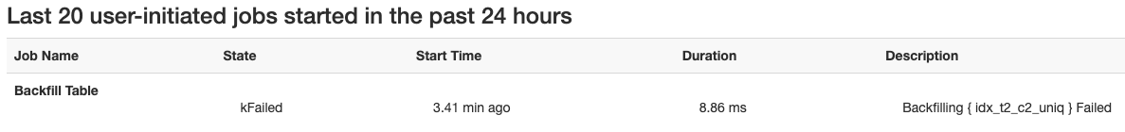
Secondary Index Creation Runs in Background ( Backfilling )
ycqlsh:test> CREATE TABLE t2 (c1 int, c2 INT, PRIMARY KEY(c1)) WITH transactions = {'enabled':true};
ycqlsh:test> INSERT INTO t2(c1, c2) VALUES (1, 1);
ycqlsh:test> INSERT INTO t2(c1, c2) VALUES (2, 1);
ycqlsh:test> CREATE UNIQUE INDEX idx_t2_c2_uniq ON t2(c2); → should fail on duplicates
ycqlsh_test>
Error reported in http://master_server:7000/tasks
Or in master logs
backfill failed for tablet…Duplicate value disallowed by unique index idx_t2_c2_uniq

Slide 29
Query Optimizer is Rule Based Only
Optimizer looks at the structure of table and all the indexes and decides the plan
No ”Cost based” or statistics based optimizer as of now. Challenges on distributed storage system

Slide 30
Types of Indexes
CREATE TABLE t2(c1 int, c2 text, PRIMARY KEY(c1));
CREATE Index idx_t2_covering_c2 on t2 ( c2 ) include (c1) ;

Slide 31
YugabyteDB Product

Slide 32
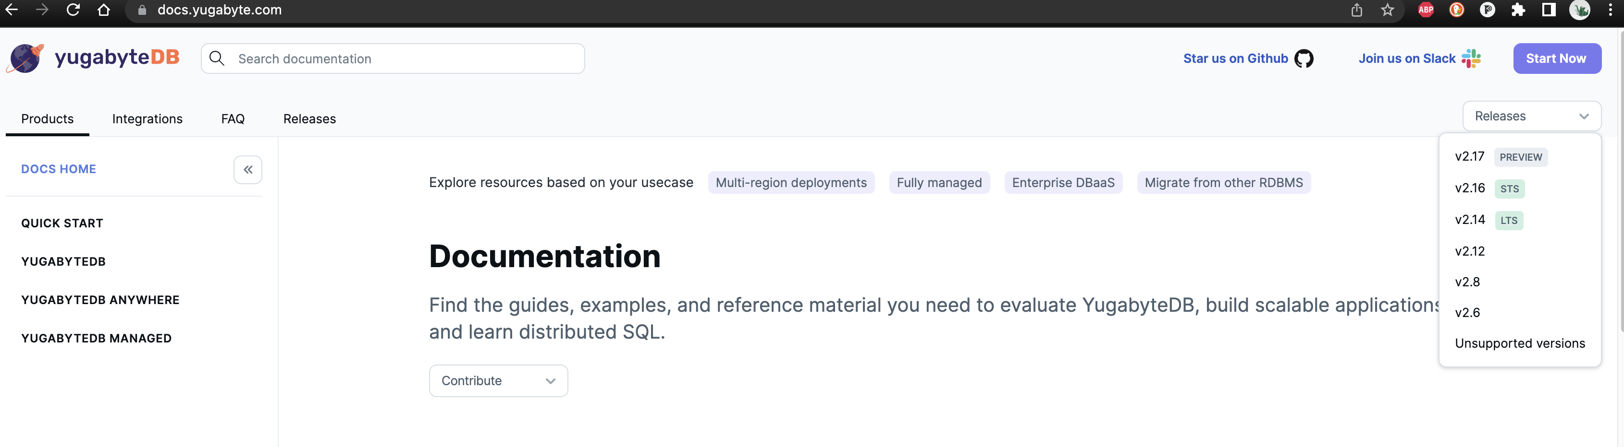
Product Lines for Yugabyute
Y..DB - Open Source database – yugabyted
Y..Anywhere - Enterprise grade monitoring, backup, replication ( BBB uses )
Y.,.\Managed) - Managed Paas on Public Cloud

Slide 33
Intro to YCQL

Slide 34
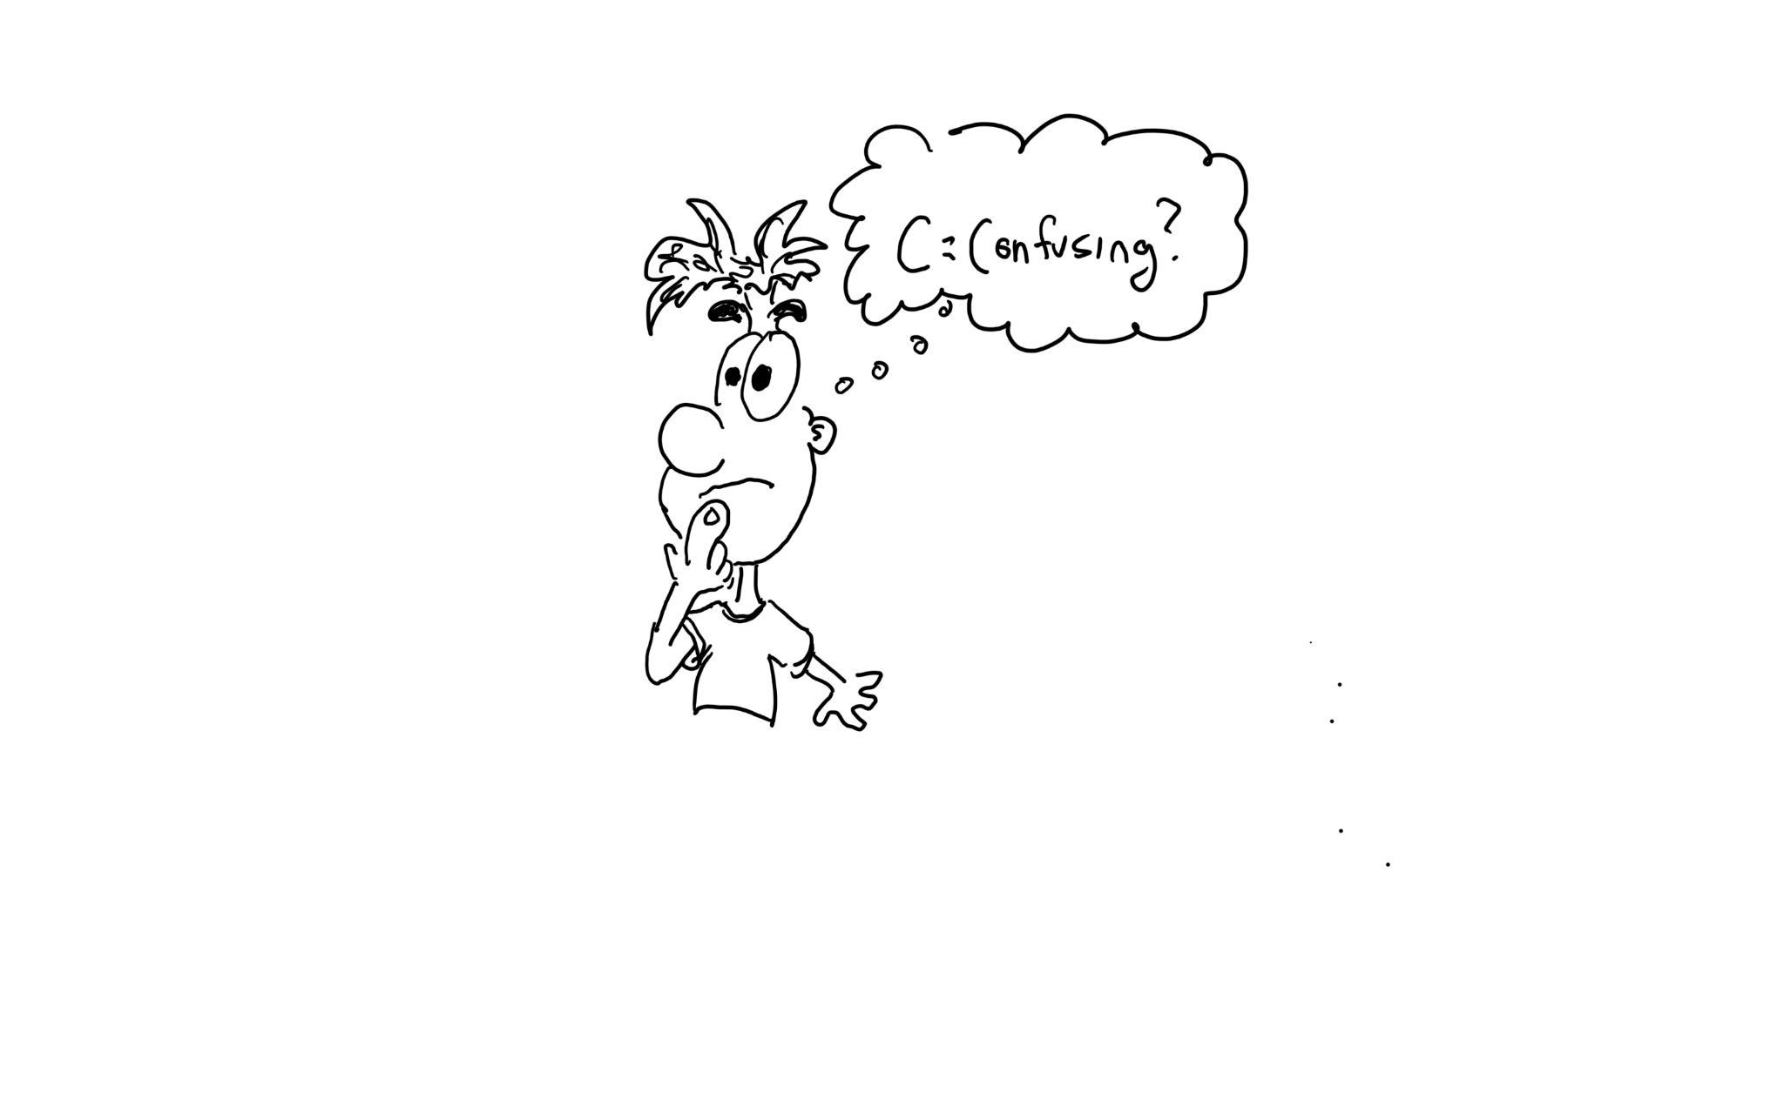

What is YCQL?
Yugabyte Cloud Query Language (YCQL) is a semi-relational SQL API that has its roots in the Apache Cassandra Query Language (CQL) What is a semi-relational data model?
Every table is required to have an ordered set of one or more primary-key columns
Data is stored in tables which have a defined schema
Table attributes can be complex data types such as sets, lists, maps, and JSONB
In a way, it’s a key value store with primary keys mapped to non-key columns as values
When I started using YCQL…
Notes:
When I first started using YCQL, I thought the “C” stood for “Confusing”! Why? It’s not relational. Defined Schema = Table fields have an assigned data type

Slide 35


YCQL vs. Cassandra
YCQL is compatible with v3.4 of Apache Cassandra QL (CQL)
YCQL is written in C++ / Apache Cassandra is written in Java
 | Cassandra | YCQL
Clustering and sharding | ✓ | ✓
Keyspaces and tables | ✓ | ✓
Indexes* | ✓ | ✓
Distributed transactions for multi-row ACID transactions | 𐄂 | ✓
Strongly-consistent reads and writes** | 𐄂 | ✓
Native JSONB | 𐄂 | ✓
Notes:
Cassandra 4.0 is GA as of July 27, 2021 Cassandra to Get ACID Transactions via New Accord Consensus Protocol

Slide 36
Getting into YCQL Data Modeling

Slide 37
YCQL Data Modeling Concepts
No foreign keys or relational integrity
Optimized for querying where queries that do not involve multiple tables
Denormalized (duplicated data)
Client-side “joins” in application code may be used to realize relationships
Picking the “right” data model is the hardest and most important part
Developers coming from a relational background usually carry over rules about relational modeling and try to apply them to YCQL
Application queries are designed/thought of first, YCQL tables are then designed to answer those queries

Slide 38
Summary of a Query-Driven Design
Unlike a relational database model in which queries make use of table joins to get data from multiple tables, joins are not supported in YCQL so all required fields (columns) must be grouped together in a single table
Since each query is backed by a table, data is duplicated across multiple tables in a process known as denormalization
Data duplication and a high write throughput are used to achieve a high read performance.
Instead of building multiple tables, secondary indexes can be used to answer queries

Slide 39
The Goals of Query-Driven Methodology
Spread data evenly across the cluster
No point in having 100s of nodes if only 2 are used
Minimise the number of partitions read by a query
Target 1 partition per read
Keep partition size manageable
Less than 100 MB

Slide 40
YCQL Secondary Indexes
Second to None!

Slide 41
Secondary Indexes
Subset of attributes
Alternate Keys
Data Validation
Increases write cost
Globally consistent
Primary Index | Secondary Index
Index key is the Primary key | Index key is not the Primary key
Must be unique | Can have duplicates
Only one primary index | Multiple secondary indexes possible
Global | Global

Slide 42
How do Indexes Work in YCQL?
Under the hood, indexes use a table that relies on distributed transactions to set multiple tablets
Index are divided into tablets and replicated across nodes like tables
The two-phase commit ensures the index is strongly consistent
Added cost on writes
Node 1
Node 2
Node 3
Node 4
tablet1
tablet2
tablet3
tablet4
tablet2
tablet3
tablet4
tablet1
tablet3
tablet4
tablet1
tablet2

Slide 43
CREATE INDEX Statement
CREATE INDEX statement
USE my_application; CREATE TABLE customer_product_order (
customer_email text,
. . .
discount_value int,
price_total int,
PRIMARY KEY (customer_email, order_date, product)
) WITH CLUSTERING ORDER BY (order_date DESC, product ASC)
AND default_time_to_live = 0
AND transactions = {'enabled': 'true'};
Table referral Name
Index Key = Condition
Enable distributed transactions
CREATE INDEX cust_prod_ord_cust_email_idx
ON my_application.customer_product_order(customer_email);
QUERY PLAN
-----------------
Index Scan using my_application.customer_product_order_cutomer_name_idx on my_application.customer_product_order
Key Conditions: (customer_email = 'jim@gmail.com')

Slide 44
Covering Indexes
USE my_application; CREATE INDEX cust_prod_ord_cust_email_idx
ON customer_product_order(customer_email)
INCLUDE(order_date, product, product_price, total_ordered);
Use INCLUDE syntax
Add attributes required by query
Index Only Scans
Doesn’t access primary table
SELECT order_date, product, product_price, total_ordered FROM customer_product_order WHERE customer_email = 'jim@gmail.com';
QUERY PLAN
-------------
Index Only Scan using my_application.cust_prod_ord_cust_email_idx on my_application.customer_product_order
Key Conditions: (customer_email = 'jim@gmail.com')

Slide 45
Unique Indexes
USE my_application; CREATE TABLE customer(customer_id INT PRIMARY KEY, customer_name TEXT, customer_email TEXT) WITH transactions = {'enabled': 'true'};
Primary Key Index
Data Validation
Disallows attribute to have duplicate values
customer_name ✅
customer_email ❌
CREATE UNIQUE INDEX cust_uidx ON customer(customer_email);
INSERT INTO customer(customer_id, customer_name, customer_email) VALUES (1, 'Jim', 'jim@gmail.com');
INSERT INTO customer(customer_id, customer_name, customer_email) VALUES (2, 'Jim', 'jim@gmail.com');
InvalidRequest: Error from server: code=2200 [Invalid query] message="Execution Error. Duplicate value disallowed by unique index cust_uidx
INSERT INTO customer(customer_id, customer_name, customer_email) VALUES (2, 'Jim', 'jim@gmail.com');
^^^^
(ql error -300)"

Slide 46
Partial Indexes
Indexes can be created on a subset of a table for more efficient queries
Less data to scan improves performance
Limit the number of customers scanned
Only stores data for a particular customer
USE my_application; CREATE INDEX customer_product_order_just_jane ON my_application.customer_product_order (customer_id, order_date) INCLUDE (order_date, product) WHERE customer_id = 2;
EXPLAIN SELECT order_date, product FROM customer_product_order WHERE customer_id = 2;
QUERY PLAN
-------------
Index Only Scan using my_application.customer_product_order_just_jane on my_application.customer_product_order
Key Conditions: (customer_id = 2)

Slide 47
Secondary Index Surprises? Not Really…
USE my_application; CREATE TABLE t (c1 INT, c2 VARCHAR, c3 VARCHAR, PRIMARY KEY (c1)) WITH transactions = {'enabled': 'true'};
CREATE INDEX t_idx1 ON t(c2);
CREATE UNIQUE INDEX t_idx2 ON t(c3);
DESC t;
CREATE TABLE my_application.t (
c1 int PRIMARY KEY,
c2 text,
c3 text
) WITH default_time_to_live = 0
AND transactions = {'enabled': 'true'};
CREATE UNIQUE INDEX t_idx2 ON my_application.t (c3) INCLUDE (c1)
WITH transactions = {'enabled': 'true'};
CREATE INDEX t_idx1 ON my_application.t (c2, c1)
WITH CLUSTERING ORDER BY (c1 ASC)
AND transactions = {'enabled': 'true'};
Primary Key column automatically added to INCLUDE clause
Primary Key column automatically added as a CLUSTERING column

Slide 48
JsonB Examples

Slide 49
JSONB
Easy search and retrieval of attributes inside the document
Attributes stored in a sorted order allowing for efficient binary search of keys
Arrays are stored such that random access for a particular array index into the serialized JSON document is possible
YugabyteDB's underlying storage engine, is document-oriented, which makes storing JSON data simpler than would otherwise be possible
CREATE TABLE customer_product_order_2 (
order_id INT,
order_detail JSONB,
PRIMARY KEY(order_id))
WITH transactions = {'enabled': 'true'};

Slide 50
JSONB Sample INSERTs
INSERT INTO customer_product_order_2 (order_id, order_detail)
VALUES (
2,
'{"customer_id":"1",
"customer_name":"Jim",
"customer_email":"jim@gmail.com",
"order_date":"2022-12-02",
"product":[{"product_id":"5",
"product":"PC",
"product_price":"1000",
"total_ordered":"1",
"product_in_stock":"10",
"distcount_code_id":"",
"discount_value":"",
"price_total":"1000"},
{"product_id":"2",
"product":"Watch",
"product_price":"60",
"total_ordered":"1",
"product_in_stock":"1000",
"distcount_code_id":"",
"discount_value":"",
"price_total":"60"}]}'
);
INSERT INTO customer_product_order_2 (order_id, order_detail)
VALUES (
1,
'{"customer_id":"1",
"customer_name":"Jim",
"customer_email":"jim@gmail.com",
"order_date":"2022-12-01",
"product":[{"product_id":"1",
"product":"Phone",
"product_price":"100",
"total_ordered":"1",
"product_in_stock":"1000",
"distcount_code_id":"1",
"discount_value":"10",
"price_total":"90"}]}'
);

Slide 51
Querying JSONB
JSONB operators allow you to query JSONB attributes directly
JSON -> ? = JSON JSON ->> ? = TEXT
SELECT order_detail->>'order_date' order_date,
order_detail->>'customer_name' customer_name,
order_detail->>'customer_email' customer_email, order_detail->'product'->0->>'product' product1,
order_detail->'product'->0->>'product_in_stock' product_in_stock1,
order_detail->'product'->1->>'product' product2,
order_detail->'product'->1->>'product_in_stock' product_in_stock2
FROM customer_product_order_2
WHERE order_id = 2;
order_date | customer_name | customer_email | product1 | product_in_stock1 | product2 | product_in_stock2
------------+---------------+----------------+----------+-------------------+----------+-------------------
2022-12-02 | Jim | jim@gmail.com | PC | 10 | Watch | 1000
(1 rows)

Slide 52
JSONB Attributes in Indexes
Use JSON operators to create indexes on JSONB attributes
ycqlsh:> USE my_application;
ycqlsh:my_application> EXPLAIN SELECT order_id FROM customer_product_order_2 WHERE order_detail->'product'->0->>'customer_email' = 'jim@gmail.com';
QUERY PLAN
-----------------------------------------------------
Seq Scan on my_application.customer_product_order_2
ycqlsh:my_application> CREATE INDEX order_detail_idx ON customer_product_order_2(order_detail->'product'->0->>'customer_email') INCLUDE (order_id);
ycqlsh:my_application> EXPLAIN SELECT order_id FROM customer_product_order_2 WHERE order_detail->'product'->0->>'customer_email' = 'jim@gmail.com';
QUERY PLAN
--------------------------------------------------------------------------------------------------
Index Only Scan using my_application.order_detail_idx on my_application.customer_product_order_2
Key Conditions: (order_detail->'product'->'0'->>'customer_email' = 'jim@gmail.com')

Slide 53
JSONB Attribute Value UPDATEs
Updating JSONB attribute values is super easy in YCQL!
ycqlsh:> USE my_application;
ycqlsh:> SELECT order_id, order_detail->'product'->0->>'product_in_stock' product_in_stock FROM customer_product_order_2 WHERE order_detail->>'customer_email' = 'jim@gmail.com';
order_id | product_in_stock
----------+------------------
1 | 1000
2 | 10
(2 rows) ycqlsh:> UPDATE customer_product_order_2 SET order_detail->'product'->0->>'product_in_stock' = '999' WHERE ORDER_ID = 1;
ycqlsh:> SELECT order_id, order_detail->'product'->0->>'product_in_stock' product_in_stock FROM customer_product_order_2 WHERE order_detail->>'customer_email' = 'jim@gmail.com';
order_id | product | product_in_stock
----------+---------+------------------
1 | Phone | 999
2 | PC | 10
(2 rows)
JSON Array

Slide 54
Adding JSONB Attributes
Adding JSONB attributes is also super easy in YCQL!
ycqlsh:my_application> CREATE TABLE t (c1 INT, c2 JSONB, PRIMARY KEY (c1));
ycqlsh:my_application> INSERT INTO t (c1, c2) VALUES (1, '{"A":"1"}');
ycqlsh:my_application> SELECT * FROM t;
c1 | c2
----+-----------
1 | {"A":"1"}
(1 rows)
ycqlsh:my_application> UPDATE t SET c2 -> 'B' = '2' WHERE c1 = 1;
ycqlsh:my_application> UPDATE t SET c2 -> 'C' = '3' WHERE c1 = 1;
ycqlsh:my_application> SELECT * FROM t;
c1 | c2
----+-----------------------
1 | {"A":"1","B":2,"C":3}
(1 rows)

Slide 55
Q&A

